Slide 1


CMR TECHNiCAL CAMPUS UGC AUTONOMOUS Accredited by NBA & NAAC with A Grade Approved by AICTE, New Delhi and Affiliated to JNTU, Hyderabad
DEPARTMENT OF COMPUTER SCIENCE AND ENGINEERING
MAJOR PROJECT
ON
A CLASSIFICATION MODEL FOR WATER QUALITY ANALYSIS
USING DECISION TREE
UNDER THE GUIDANCE OF :- PRESENTED BY:-
SUMA S ROHIT MOON
(Assistant Professor) (177R1A05G4)
MOHAMMAD UMER
(197R1A05Q1)

Slide 2
ABSTRACT
The water quality is very important in ensuring citizens get to drink clean water. Application of decision tree as a data mining method to predict clean water based on the water quality parameters can ease the work of the laboratory technologist by predicting which water samples should proceed to the next step of analysis.
The data model was implemented in WEKA software. Classification using decision tree was applied to classify /predict the clean and not clean water.
Five decision tree classifiers which are J48, LMT, Random forest, Hoeffding tree and Decision Stump were used to build the model and the accuracy compared.

Slide 3
EXISTING SYSTEM
Muharemi et al., 2018 proposed the Nearest Neighbor Algorithm (KNN) and the Neural Network of Classification based on Logistic Regression to obtain an adequate solution to address the problem of changes in the quality of drinking water. Haghiabi et al., (2018) investigated the performance of artificial intelligence techniques that include the artificial neural network (ANN),the group data management method (GMDH) and the support vector machine (SVM) to predict the components of the water quality of the Tireh River located in southwestern Iran.
Zhang et al., (2017) proposed a new anomaly detection algorithm for water quality data using double-movement windows over time, which can identify historical pattern anomaly data in real time. The algorithm is based on statistical models, autoregressive linear combination model. The algorithm has been tested using water quality PH data at 3 months from a real water quality monitoring station on a river system. The experimental results show that their algorithms can significantly decrease the false positive rate and have a better anomaly detection performance than the AD and ADAM algorithms.

Slide 4
DISADVANTAGES
This system uses a smaller number of algorithms to build model.
Accuracy is less and performance is not optimized.

Slide 5
PROPOSED SYSTEM
The data analysis tool used in this study is WEKA which is a data mining software developed by the University of Waikato in New Zealand that apparatus data mining algorithms using the JAVA language. Weka is a milestone in the history of the data mining and machine learning research communities, because it is the only toolkit that has gained such widespread adoption.
Various decision tree algorithms are used in classification like ID3, AD Tree, REP, J48, FT Tree, LAD Tree, decision stamp, LMT, random forest, random tree etc. In this work the decision trees which were considered are J48, LMT, Random Forest and Random tree for comparison purposes and all those decision tree algorithms are found in WEKA.

Slide 6
ADVANTAGES
Algorithms like Random forest, FT Tree, LAD Tree, decision stamp, LMT.
Accuracy is more than existing system.
User friendly UI using Flask.

Slide 7
Hardware requirements
System : Minimum of Intel core i3 processor.
Hard disk : 16 GB
Monitor : 14’ Colour Monitor.
Mouse : Optical Mouse.
RAM : 4 GB

Slide 8
Software Requirements
Operating system : Windows 7 or above
Coding Language : Python 3.8
Designing : IDE – VS Code

Slide 9
NOVELTY
Water is perhaps the most precious natural resource after air. Though the surface of the earth is mostly consists of water, only a small part of it is usable, which makes this resource limited. This precious and limited resource, therefore, must be used with care. As water is required for different purposes, the suitability of it must be checked before use.
In industries, improper quality of water may cause hazards and severe economic loss. Thus, the quality of water is very important in both environmental and economic aspects. Thus, water quality analysis is essential for using it in any purpose.

Slide 10
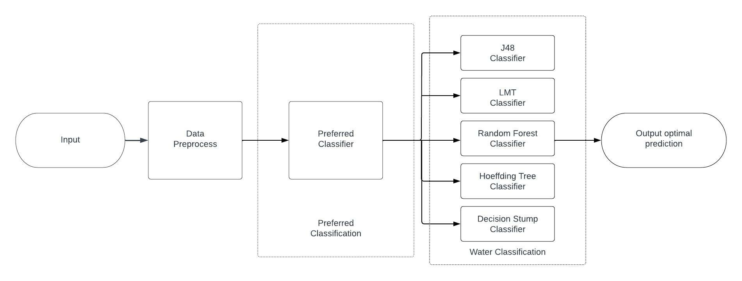
Architecture

Slide 11
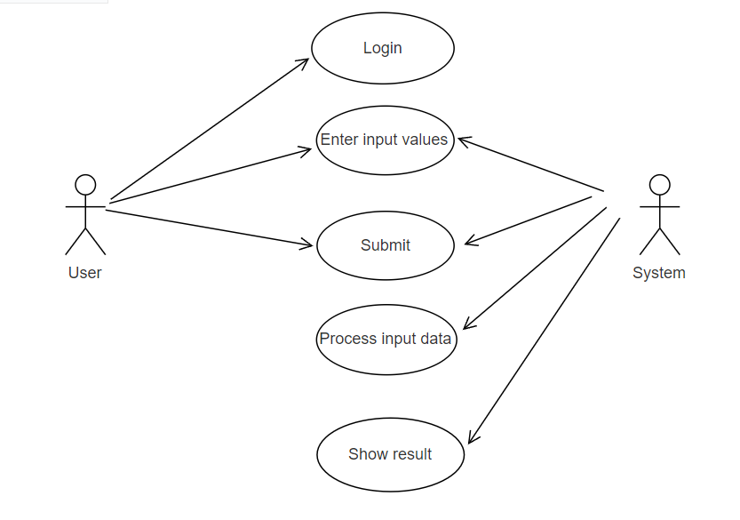
Use Case Diagram

Slide 12
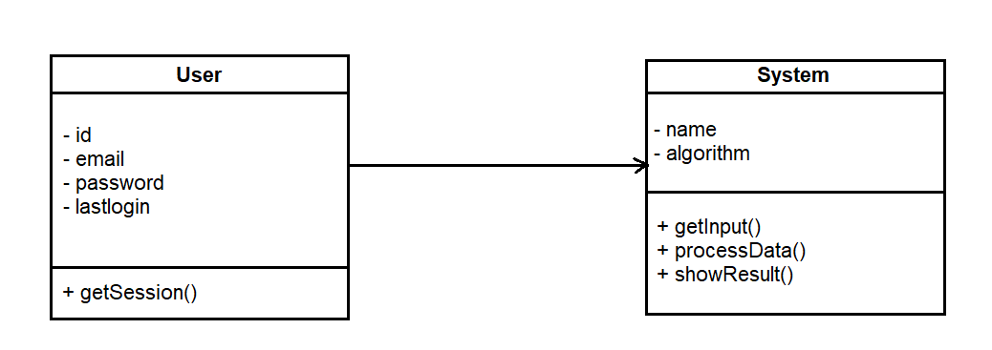
Class diagram

Slide 13
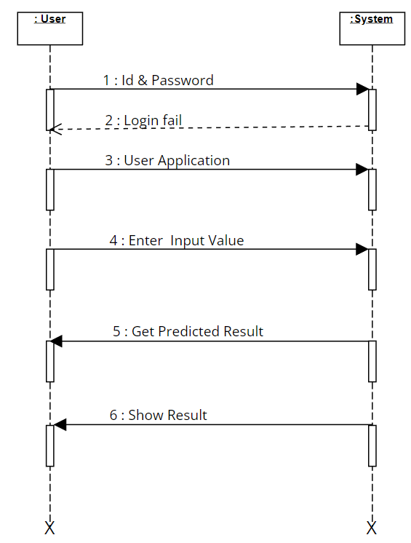
Sequence Diagram

Slide 14
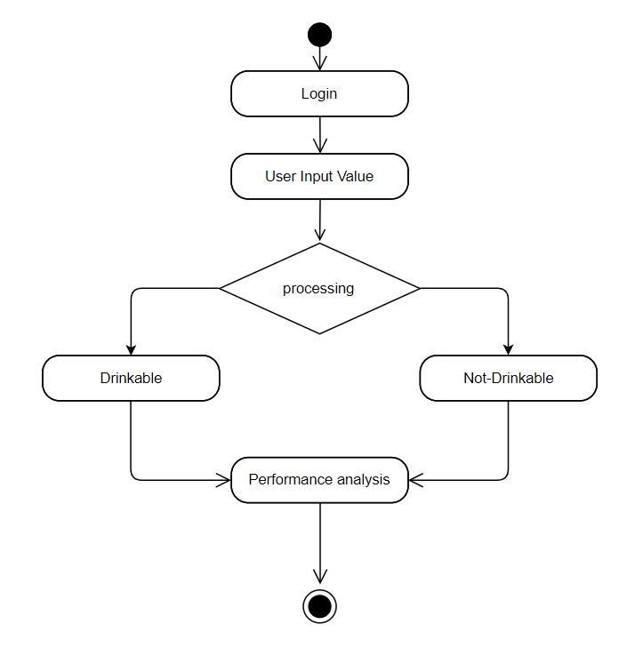
Activity Diagram

Slide 15
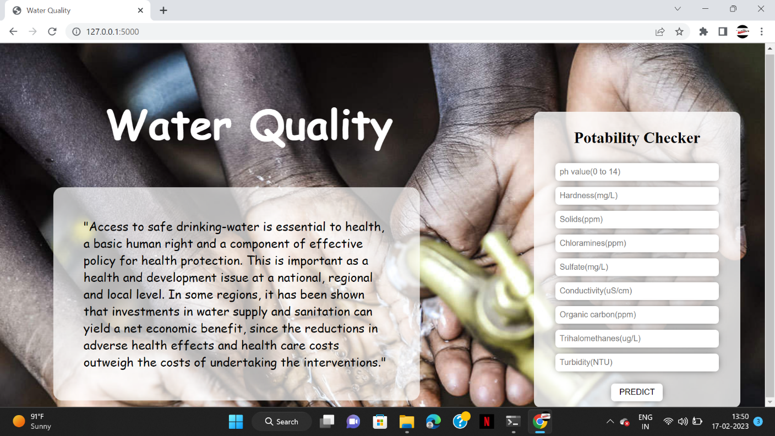
RESULTS
Fig 1. User Interface of the Application

Slide 16
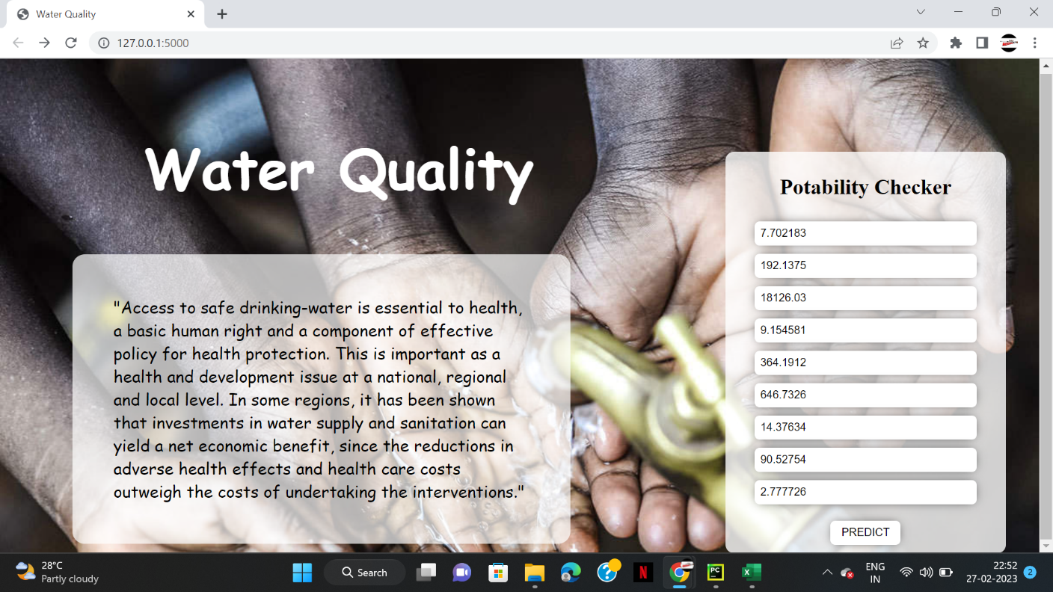
RESULTS
Fig 2. Taking a values from a river water.

Slide 17
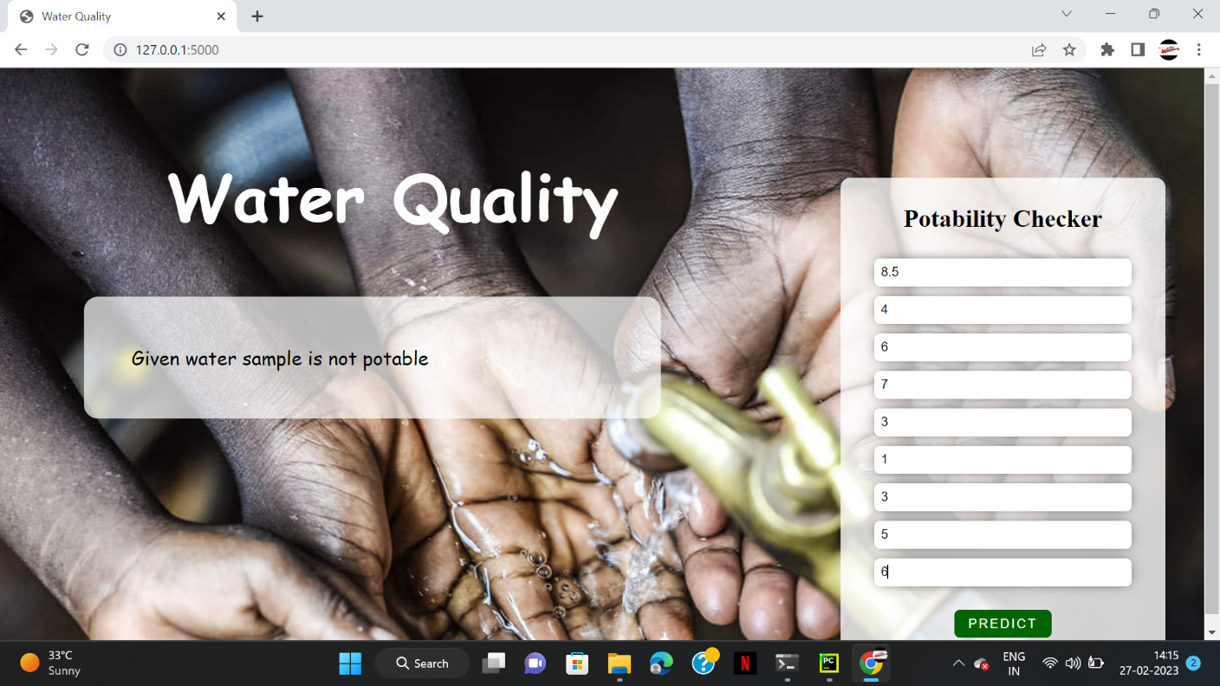
RESULTS
Fig 3. Result for given water sample is not portable

Slide 18
CONCLUSION
In this study, water quality model was implemented using decision tree technique. The analysis of water Alkalinity level and conductivity can play a major role in assessing water quality. Five decision tree classifiers which are J48,LMT,Random forest, Hoeffding tree and Decisions ump were used to build the model and the accuracy compared. J48 decision tree had the highest accuracy of 94% with Decisions ump having the lowest accuracy of 83%.The decision tree classifier provided with quality water parameters set by WHO and KEBS can be used to predict whether drinking water is clean or not.

Slide 19
REFERENCES
Karanfil, O., & Konar, A. (2018). Development of a decision tree-based classification model for surface water quality. Environmental Monitoring and Assessment, 190(3), 171.
Saravi, S. S. S., & Malekian, A. (2019). Application of decision tree algorithm for prediction of water quality index (WQI). Journal of Water and Land Development, 43(1), 18-27.
Esakkirajan, M., & Thanushkodi, K. (2017). Decision tree based approach for water quality classification using WQI parameters. Journal of King Saud University-Engineering Sciences, 29(4), 318-324.
Ferreira, R. B., Lopes, J. A., & Ribeiro, R. (2018). Decision trees for monitoring and management of water quality in small and medium-size water supply systems. Water Science and Technology: Water Supply, 18(6), 2006-2013.
Jha, P., & Kumar, R. (2016). A novel decision tree approach for water quality prediction in rivers. Journal of Hydroinformatics, 18(1), 116-131.
Wang, Y., Zhan, C., Li, M., Chen, G., & Liu, Y. (2019). An improved decision tree method for water quality assessment of rivers. Journal of Cleaner Production, 210, 1001-1012.
Chatterjee, D., & Panchal, V. (2019). Water quality assessment of Ganga River basin using decision tree analysis. Environmental Earth Sciences, 78(19), 578.

Slide 20
GITHUB LINK
https://github.com/rohitmoon/water-quality-qualification

Slide 21
THANK YOU

